Slide 1







Capstone Project Phase 2 B-24-1-R-2 SonicCipher
Michael Ioffe
315388900
Shay Zak
312330749
Supervisor
Alex Keselman

Slide 2
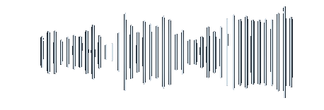
Introduction
Developed a real-time voice-to-text and translation web app.
Integrated Google Speech-to-Text, Translate, and ChatGPT APIs.
Enabled secure, bidirectional voice translation.
Supported live video meetings with real-time speech translation.
while Ensuring privacy with peer-to-peer connections.
Notes:
In today’s globalized world, breaking language barriers is essential for effective communication. Our project delivers a web application that captures speech, converts it to text, and translates it into another language in real time. We’ve integrated powerful technologies like Google Speech-to-Text, Google Translate, and ChatGPT to ensure accurate and fast translations. The app also supports live video meetings with real-time translation, enabling seamless multilingual conversations. With secure peer-to-peer connections and encryption, our application ensures privacy, making communication across different languages easy, accessible, and secure.

Slide 3

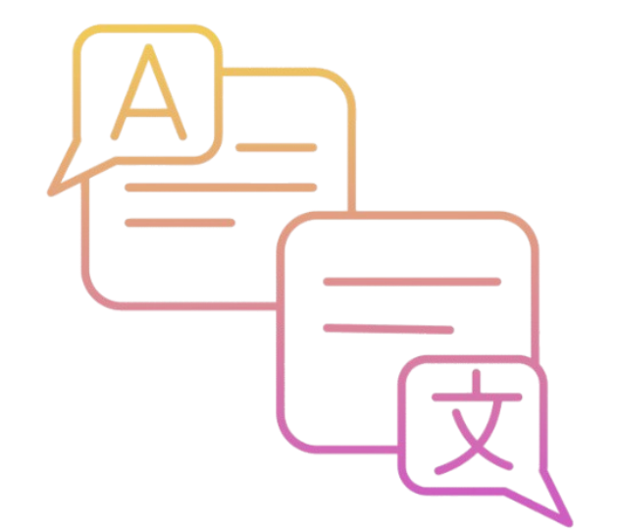

The Problem
Language Barriers:
Communication is challenging when
people speak different languages,
especially in real-time.
Inaccurate Translations:
Many existing tools provide literal
translations that miss context,
causing misunderstandings.
Time-Consuming:
Switching between multiple apps for
translation during conversations
slows down communication.
Notes:
"Language barriers complicate real-time communication. Current tools often provide inaccurate translations that miss context, causing misunderstandings. Switching between apps for translation disrupts conversations and wastes time. Our project addresses these issues by making cross-language communication more accurate and efficient."

Slide 4
The Solution
Real-Time Translation
Live Video Translation
User-Friendly Design
Context-Aware Translations
Notes:
Our solution provides a user-friendly web application that bridges language barriers in real time. With a simple and intuitive interface, users can speak naturally while the app delivers instant speech-to-text and contextual translations. We’ve integrated live video translation to support dynamic conversations, ensuring seamless communication across languages. Additionally, all interactions are secured with end-to-end encryption, safeguarding user privacy. Our app makes cross-language communication easy, accurate, and secure."

Slide 5
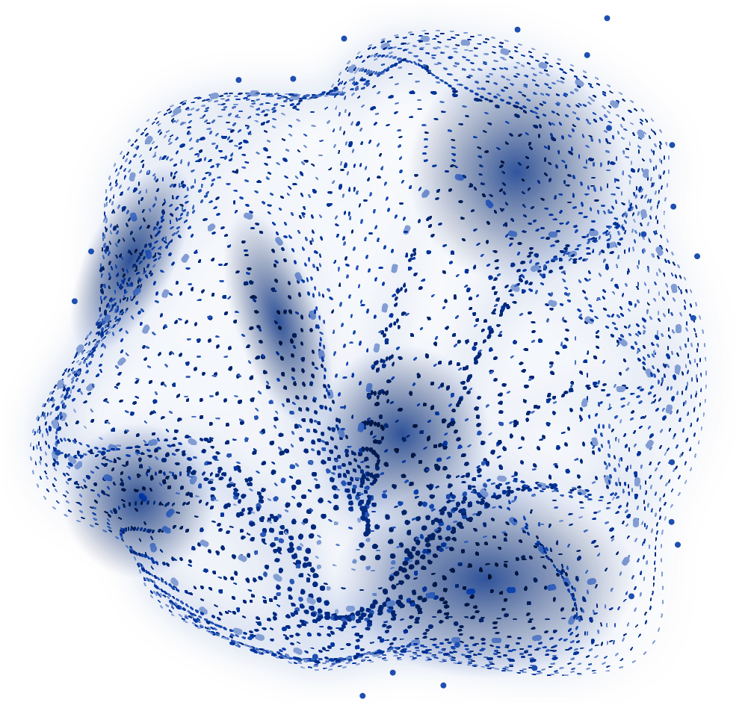
System Main Requirements:
Real-Time Translation Speed
High Accuracy in Context
Simple, Accessible Design and Cross-Platform Functionality
Secure and Private Communication (Video)
Scalable Performance
Notes:
Our system focuses on delivering real-time translation with high accuracy to ensure effective communication. It’s designed to be simple and accessible across all devices, offering a seamless user experience. The system prioritizes secure and private communication through end-to-end encryption. Additionally, it’s built to scale, accommodating more users and languages without compromising performance.

Slide 6


What Happens Behind The Scenes?

Slide 7



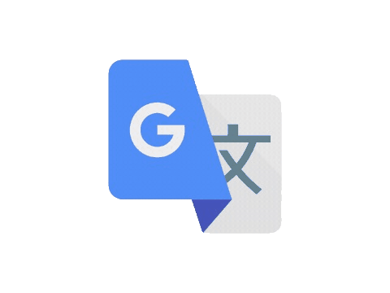

Free Method
Languages Selection
Input Capture (Voice or Text)
Google Speech-to-Text API (if Voice)
Display and Voice Output
Translation with Google Translate API
Notes:
"In the free translation mode, users can select their input and output languages and choose to either speak or type their text. If they speak, the voice is converted into text using Google Speech-to-Text. The text is then sent to Google Translate for quick, basic translation. Finally, the translated text is displayed on the screen and can be read aloud using Google Text-to-Speech, making communication fast and straightforward."

Slide 8
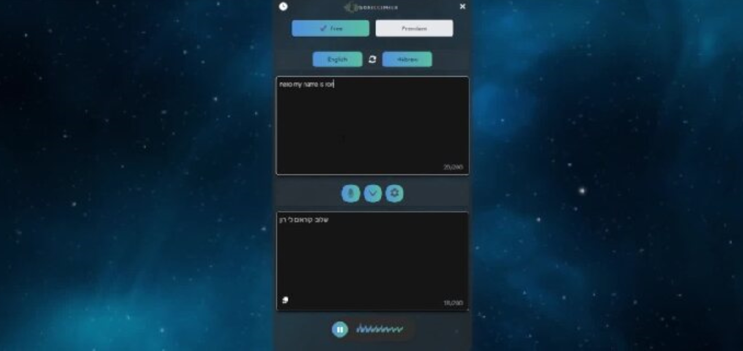
https://sonic-cipher-omega.vercel.app/translator

Slide 9
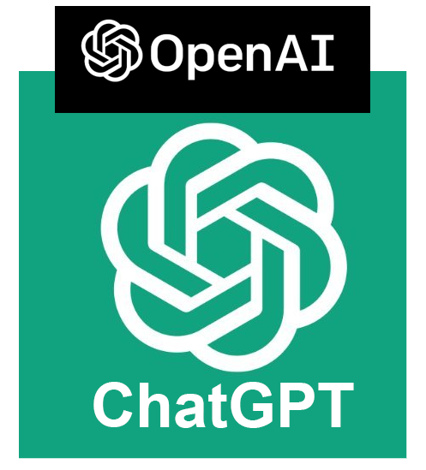
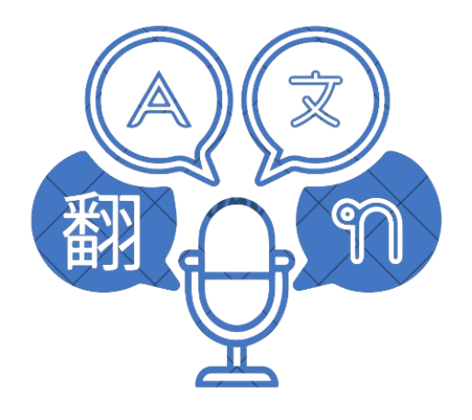
Premium Method
Enhanced Input Options:
Users can speak or type their text, similar to the free method.
Context-Aware Translation:
Uses OpenAI’s ChatGPT-4 for nuanced and accurate translations.
Customization:
Users can add specifications like tone, formality, or target audience to adjust the translation style.
Notes:
Our system focuses on delivering real-time translation with high accuracy to ensure effective communication. It’s designed to be simple and accessible across all devices, offering a seamless user experience. The system prioritizes secure and private communication through end-to-end encryption. Additionally, it’s built to scale, accommodating more users and languages without compromising performance.

Slide 10
Premium Method
Advanced User Options:
User Profile Creation:
Users can create a profile stored in local memory to save preferences.
Saved Modifications:
Profiles allow users to store translation modifications and settings.
Consistent Experience:
Saved settings are sent to ChatGPT-4, ensuring translations match the user’s style and preferences.
Notes:
Our system focuses on delivering real-time translation with high accuracy to ensure effective communication. It’s designed to be simple and accessible across all devices, offering a seamless user experience. The system prioritizes secure and private communication through end-to-end encryption. Additionally, it’s built to scale, accommodating more users and languages without compromising performance.

Slide 11

How It Works
STEP 1
The generated text, language selection, and user specifications and the profile specifications are combined.
STEP 2
An HTTP request sends this data to the backend server.
STEP 3
The server processes the translation, integrating all details, including user profile settings.
STEP 4
Translated text is sent back
Notes:
"When the user inputs text or speech, it’s combined with their selected language, tone, and any additional specifications, like formality or phrasing style. This data is sent to the backend via an HTTP request, where it’s processed. The backend constructs a custom prompt using the user's input, incorporating all the provided details. This prompt is then sent to OpenAI’s GPT-4 API, ensuring the translation reflects the desired tone and context. The API responds with a refined translation, which is sent back to the user in real time."

Slide 12
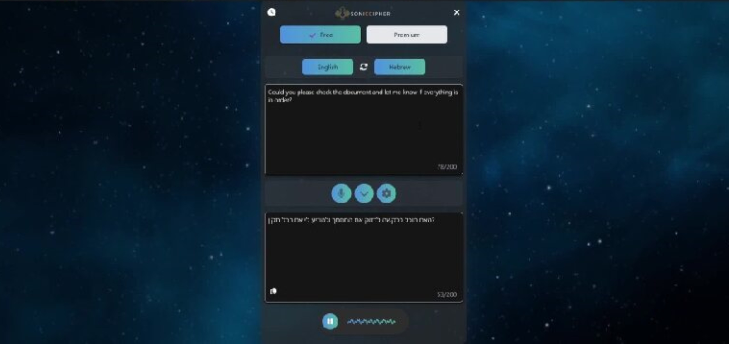
https://sonic-cipher-omega.vercel.app/translator

Slide 13
Extra Features Premium Translation

Slide 14
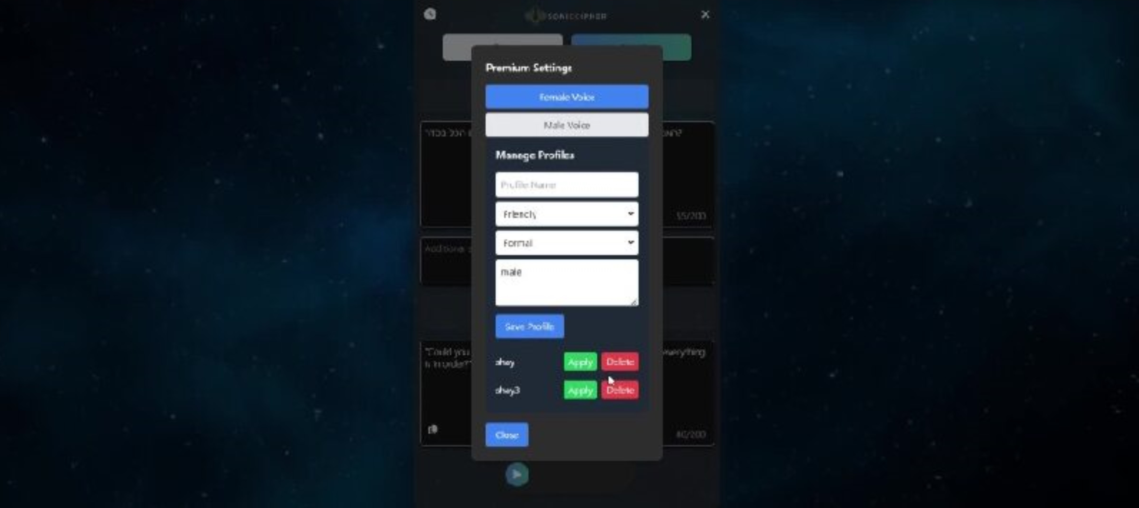
https://sonic-cipher-omega.vercel.app/translator

Slide 15
Creating A Query
const prompt = `You are an expert translator specializing in translating text from ${source} to ${target}. Please provide a translation that accurately reflects the original meaning with the following specifications:
- Tone: ${tone || 'neutral'} (ensure the translation maintains a polite, straightforward tone suitable for formal communication).
- Formality: ${formality || 'formal'} (language should remain professional and respectful, using plural forms when appropriate).
- Preferred Phrasing Style: When translating instructions or requests, use phrasing that sounds slightly more indirect and polite. For example, prefer "עברו על" instead of "סקור" and similar polite variations over more direct instructions.
- Additional Context: Avoid overly instructional or commanding language; maintain a respectful tone as if addressing a professional audience.
- Additional specifications: ${additionalText || 'none'}
Here are some example translations to guide the style:
1. English: "Please review the attached document." -> Hebrew: "אנא עברו על המסמך המצורף."
2. English: "Ensure the task is completed by the end of the week." -> Hebrew: "ודאו שהמשימה תושלם עד סוף השבוע."
Now translate the following text:
"${q}"`;
Notes:
"This code handles the premium translation process. It takes the user's input, including the text, source and target languages, and additional specifications like tone and formality. These details are combined into a prompt tailored for OpenAI's GPT-4 API. The API then returns a translation that respects the user’s preferences. We log the data at every step, ensuring that everything is processed correctly, and return the refined translation to the user."

Slide 16
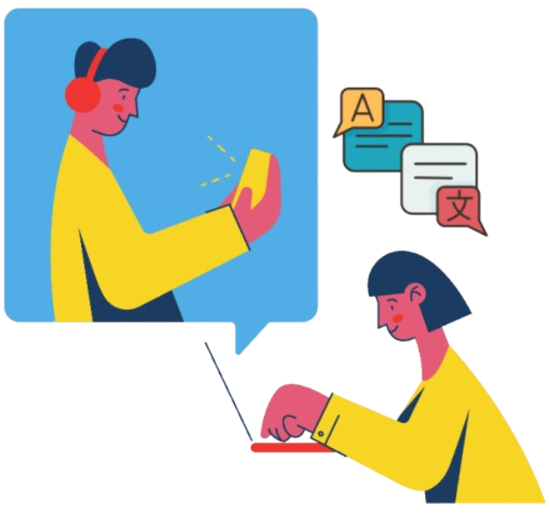
Real-Time Video Translation
Integrated Video Chat:
Real-time translation during video calls.
Instant Transcription:
Speech is transcribed and translated on the fly.
Language Selection:
Choose source and target languages for translation.
Notes:
"In our real-time video translation feature, users can engage in video calls with real-time translation capabilities. The system transcribes speech instantly and translates it on the fly, ensuring smooth communication across languages. Users have the flexibility to select their source and target languages, making the interaction seamless and adaptable to different needs. This feature is designed to break down language barriers during live conversations, making communication more accessible and effective."

Slide 17
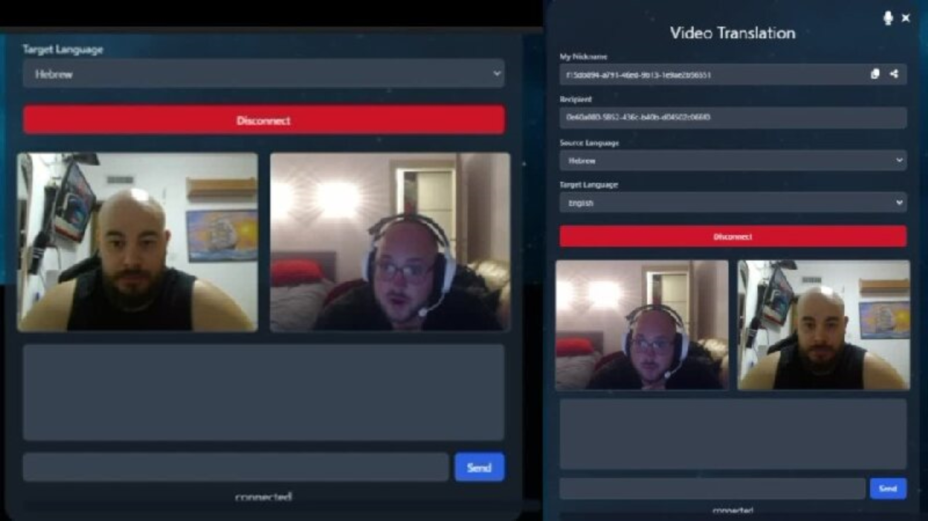

Slide 18
Real-Time Video Translation
How Video Translation Works
Real-Time Peer Connection::
Utilizes PeerJS for establishing a secure, low-latency connection, ensuring smooth video and audio communication.
Speech-to-Text and Translation API:
Converts spoken language to text and instantly translates it between languages.
Subtitle Display:
Translated text shows as subtitles during the call.
Notes:
our video translation leverages several advanced technologies. We use PeerJS for establishing a secure and low-latency connection, ensuring that video and audio communication remain uninterrupted. The Speech-to-Text and Translation API plays a crucial role by converting spoken language to text and translating it instantly. This translated text is then displayed as subtitles during the video call, enabling users to follow the conversation in real time, regardless of the languages being spoken. This setup ensures a reliable, accurate, and user-friendly translation experience during live video interactions."

Slide 19
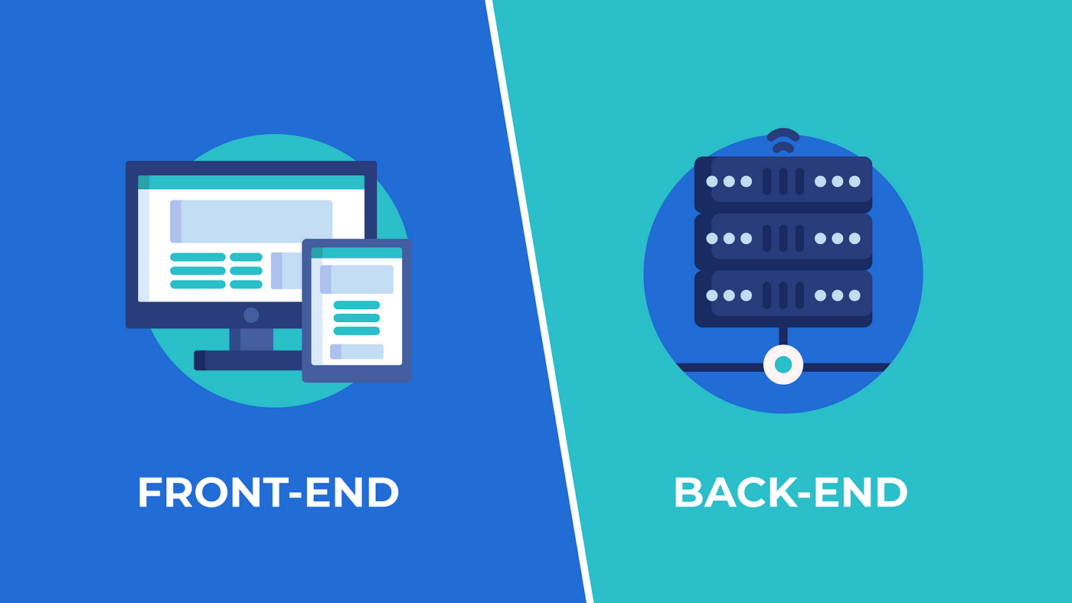

Deploy
Deploying frontend via
Vercel is a platform that specializes in hosting frontend projects, offering features tailored to the needs of modern web applications.
Deploying Back via
Our backend Is deployed in vercel as server which holds the enviorment keys (APIS, senstive data)

Slide 20








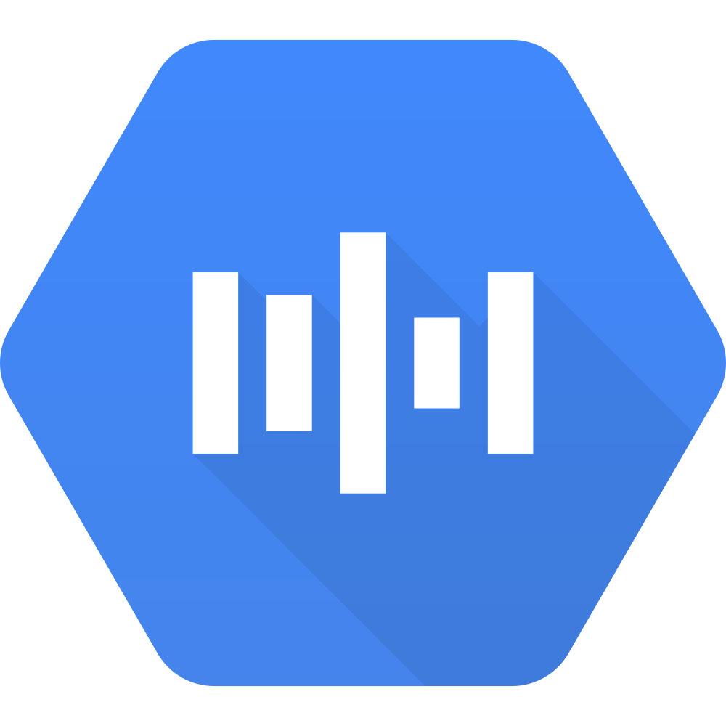




Architecture
Committed To
Frontend
Backend
+
User
Browser
Server
API`S
+
+
+

Slide 21
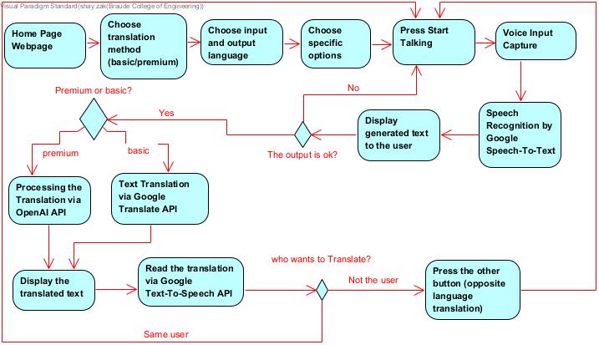
Activity Diagram
Notes:
"This code handles the premium translation process. It takes the user's input, including the text, source and target languages, and additional specifications like tone and formality. These details are combined into a prompt tailored for OpenAI's GPT-4 API. The API then returns a translation that respects the user’s preferences. We log the data at every step, ensuring that everything is processed correctly, and return the refined translation to the user."

Slide 22
Challenges and Solutions
Challenges | Solutions
Optimizing Prompt for OpenAI API – Creating an optimal prompt for accurate and relevant responses. | Dedicate time to extensive experimentation and optimization to refine the prompt based on user inputs.
Dependency on Chat GPT Model Versions – Dependency on specific model versions impacting functionality and performance. | Implement request throttling and caching mechanisms. Consider batching requests and optimizing API usage.
User Interface Consistency – Ensuring a consistent user experience across different translation modes (Google vs. OpenAI). | Maintain a unified UI/UX by using the same frontend components for both translation services. Introduce subtle visual cues to indicate the active translation service without disrupting the user experience.
Error Handling and Logging – Managing and tracking errors across the application in real-time. | Implement robust error handling mechanisms in both frontend and backend

Slide 23
Thank you for listening!

